Slide 1
Determination of Glucose in Body Fluids
Presented by: Dr. Rahmati

Slide 2
Introduction
Carbohydrates are one of the most important organic component in body.
Make 50-70% of energy
Glucose is the major carbohydrate in our body.
Its plasma level controls by some hormones:
Insulin: Decreasing agent (Diabetes Mellitus)
Glucagon, epinephrine, ACTH, Growth hormone (GH), thyroxin (T4), cortisol, … could act as increasing agents.
Significance of carbohydrate measurement?

Slide 3
Fasting Blood Sampling (FBS)
Fasting (8-14 hours)
Sterile requirements
Sterile sampling place with alcohol 70%
Fit needle
Put the sample in the lab for 30 min after sampling then centrifuge it
Note: Infant sampling is hard.

Slide 4
Methods
With different specificity and sensitivity
Chemical Methods
Enzymatic Methods

Slide 5
Chemical Methods
Oxidation-Reduction Methods
Glucose converts to gluconic acid that reductes Cu++ to Cu+ and makes color.
Somogyi-Nelson
Folin-Wu
Condensation Methods
Glucose reacts with aromatic component and makes color in warm diluted acid condition.
Orto-Toluidine

Slide 6
Somogyi-Nelson
Glucose + Cu2+ Gluconate + Cu+
pH>7 , Heat
Cu+ + arsenomolybdate Blue molybdenium complex
OD measuring in 660nm Wavelength

Slide 7
Folin-Wu
Glucose + Cu2+ Gloconate + Cu+
pH>7 , Heat
Cu+ + phosphomolybdate Blue molybdenium complex
OD measuring in 660nm Wavelength

Slide 8
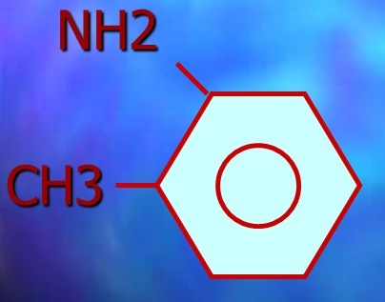
Orto-Toluidine
O-Toluidine + Glucose Glycosylamine
Schiff base
Color complex (aniline –benzidine)
OD measuring at 630 nm wavelength

Slide 9
False Positive Making Substrates
They have similar absorbance wavelenght with glucose
Bilirubin
Galactose
Mannose
Ribose
Hemoglobin
Vitamin C
Uric acid
Glutathione (G-SH)

Slide 10
Enzymatic Methods
Glucose Oxidase (Routine method)
Hexokinase (Gold standard)
Glucose dehydrogenase

Slide 11
Glucose Oxidase
mutarotase
α-D-Glucose β-D-Glucose
Glucose oxidase O2
Gluconic acid + H2O2
Peroxidase
H2O2 + chromogen color complex + H2O
(o-dianisidine)
(phenylamine)
OD measuring at 500-540nm wavelength

Slide 12
Clinical Significance
For Fasting Blood Sugar (FBS)
Fasting 8-14 hours
Normal range: 70-110 mg/dL
FBS < 70mg/dL : Hypoglycemia
FBS > 110mg/dL: Hyperglycemia

Slide 13
Hyperglycemia
If FBS > 126mg/dL
It could be:
Primary that causes:
Diabetes Mellitus
Insulin Dependent Diabetes Mellitus (IDDM) or Type I
Non-Insulin Dependent Diabetes Mellitus (NIDDM) or Type II
Secondary

Slide 14
Hyperglycemia Clinical signs
Random blood sugar > 200mg/dL
Increased thirst and a dry mouth.
Needing to pee frequently (Poly urination).
Tiredness
Blurred vision
Unintentional weight loss.
Recurrent infections, such as thrush, bladder infections (cystitis) and skin infections.

Slide 15
IDDM or Type I
Autoimmune disease (beta cells destroys in pancreas)
Absolute deficiency of insulin
Make up about 10% of all patients with D.M
IDDM present at early age (before 30 years old)
Clinical signs:
High blood glucose
Low blood insulin
Ketosis
Loss of body weight
- exhaled acetone

Slide 16
NIDDM or Type II
Deficiency of insulin receptor
Patients are commonly obese
Is the most common of D.M. (80-90%)
Usually present at age over 40
Clinical signs:
High blood glucose
Normal or increased blood insulin
Osmotic diuresis
Dehydration

Slide 17
Other Diabetes Mellitus
Prediabetes mellitus or impaired fasting glucose (IFG):
FBS is between 110 – 126mg/dL
It is a sign of Type II DM but is not Type II DM yet.
Helps us to have a good control.
GDM (gestational diabetes mellitus):
As glucose intolerance of variable degree with onset or first recognition during 24 and 28 weeks of pregnancy.
In which a hormone made by the placenta prevents the body from using insulin effectively
OGTT is needed for detection (<140mg/dL is normal and >190mg/dL is diabetes)

Slide 18
Secondary Hyperglycemia
Pancratectomy (Decreased insulin)
Acromegaly (increased GH)
Cushing's syndrome (Adrenal hyper activity and increased cortisol)
Glucagonoma (benign pancreatic tumor)

Slide 19
Hypoglycemia
In adult: FBS < 45-50mg/dL
In infant:
Preterm <25mg/dL
Fullterm <35mg/dL

Slide 20
Causes of Hypoglycemia
Insulinoma (islant cell tumors)
Glycogen storage Diseases (GSD)
Addison Disease

Slide 21
OGTT (Oral glucose Tolerance Test)
Fasting 90mg/dL
1hour 140mg/dL
2 hours 115mg/dL
3hours 90mg/dL

Slide 22
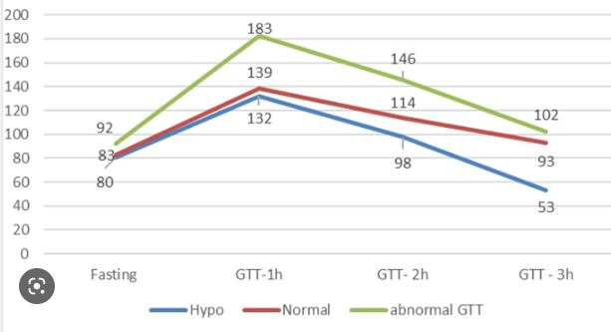
OGGT Curve

Slide 23
2hpp Blood Sugar
2hpp (Two hours postprandial plasma glucose) used to screen for diabetes mellitus and to monitor glucose control

